Slide 1





Examine EZ-Diffusion Parameters for Two Experimental Conditions
By: Ekram Alvi

Slide 2
Background
Experiment & Model

Slide 3
Confidence in masked orientation judgments is informed by both evidence and visibility
Rausch et. al., 2018

Slide 4
Dataset – Rausch 2018 Exp1
The present study proposes a new model of confidence in visual decisions, the weighted-evidence-and-visibility model (WEV). The core idea is that confidence judgments are influenced by two internal variables: the evidence as well as the visibility of the stimulus
A total of 20 participants (three male, 17 female) took part in the experiment. Participants were instructed to report the orientation of the grating and their confidence in being correct on the orientation judgment as accurately as possible without time pressure. The experiment consisted of one training block and nine experimental blocks of 60 trials each. The orientation of the target stimulus varied randomly across trials. In total, there were 20 different unique tasks.

Slide 5
Computational Models of Response Time
EZ – Diffusion moDel

Slide 6
EZ Diffusion Model
The diffusion model is a model of the cognitive processes involved in simple two-choice decisions.
It separates the quality of evidence entering the decision from decision criteria and from other, nondecision, processes such as stimulus encoding and response execution.
The EZ diffusion model is a restricted version of the diffusion model with some parameter variability set to zero, allowing for quicker analyses.
Parameters: Boundary, Drift, Non-Decision, Reaction Time, Reaction Accuracy

Slide 7
Secondary Data Analysis
Exploratory Data Analysis

Slide 8
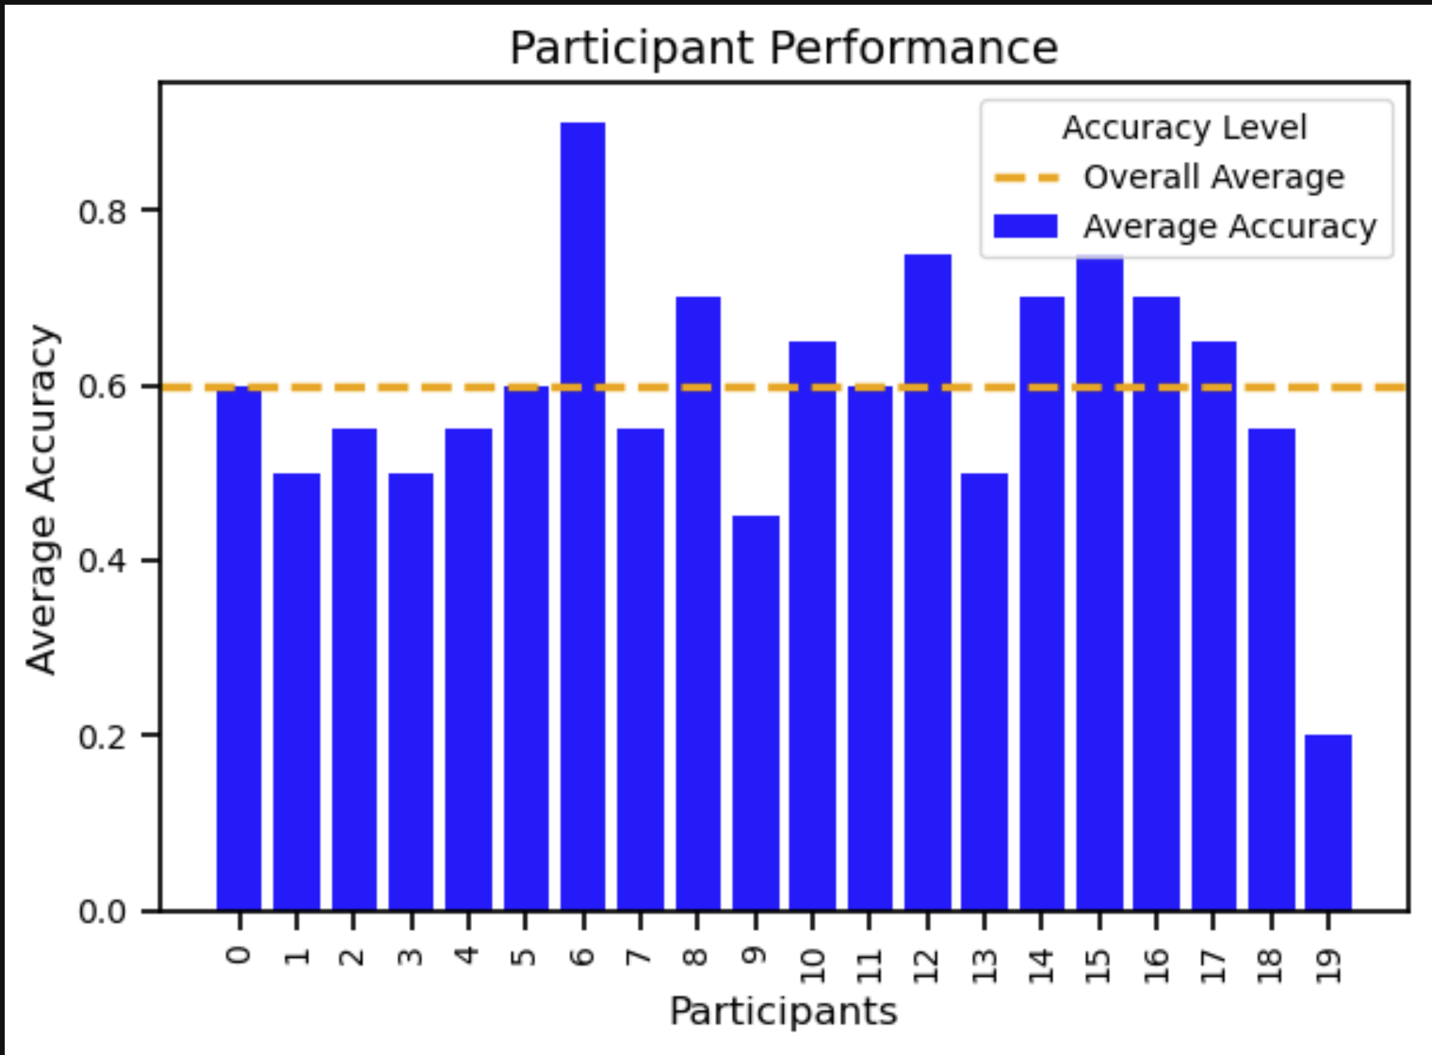
Participant Performance – Response Accuracy

Slide 9
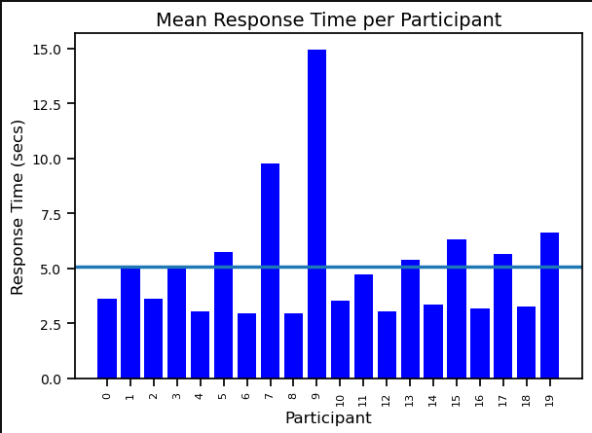
Participant Performance – Response Time

Slide 10
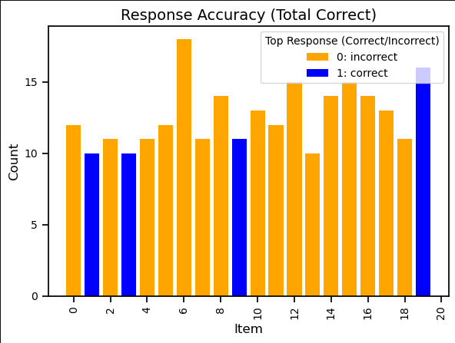
Item Performance – Response Accuracy

Slide 11
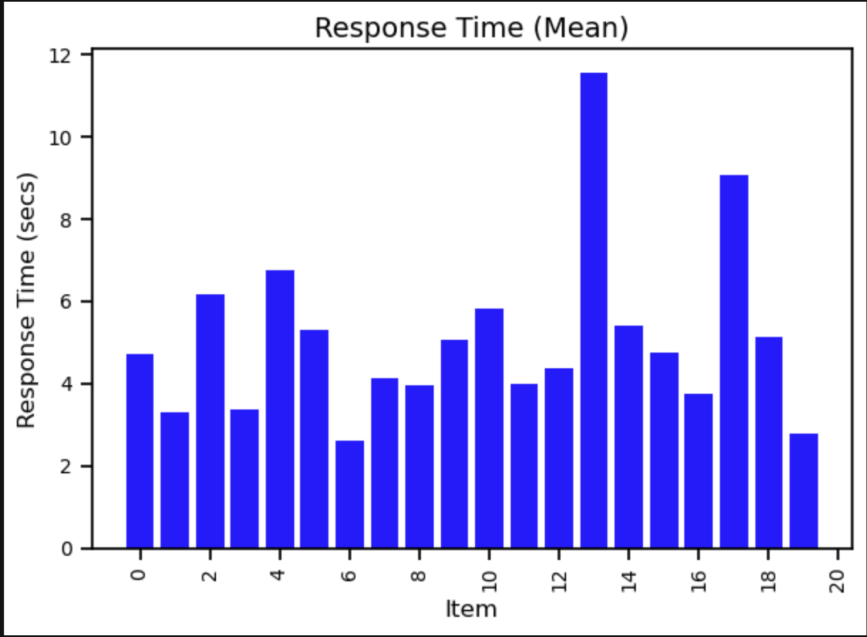
Item Performance – Response Time

Slide 12
Secondary Data Analysis
Cognitive Model – EZ Diffusion Model

Slide 13
EZ-Diffusion Model
The beauty of this model is that it provides a way to separate out these different aspects of the decision-making process, which can be very useful in understanding the cognitive processes underlying performance in a task.
Boundary Separation: How much information is needed to make a decision. Higher values mean slower but more accurate decisions.
Drift Rate: The speed and direction at which evidence is being collected. Higher values mean faster decisions.
Non-decision Time: The time spent on processes other than decision-making, such as understanding the task or preparing the response.

Slide 14
Parameter Estimation Method
Parameter Estimation: The process of using data to determine the values for parameters in a model that best represent the data. In Bayesian statistics, we compute a range of plausible values for the parameters (posterior distribution), rather than a single "best" value.
NUTS (No-U-Turn Sampler): A modern Markov chain Monte Carlo (MCMC) sampling method used in Bayesian statistics to estimate the posterior distribution of model parameters. It is efficient and requires fewer tuning parameters than older MCMC methods. It's named after its strategy to avoid making U-turns while sampling.

Slide 15
Current Study
For both reaction time and accuracy, the data was split based on item/task – to either easy or hard.
The original data frame is queried based on top correct or incorrect and then put into two separate datasets:
Dataset1_easy: Participants:20, items:11
Dataset2_hard: Participants:20, items:9
The new data frames were then separated and ran through the EZ-diffusion model with all steps repeated for each.

Slide 17
Results
Graphing from both easy and hard datasets

Slide 18
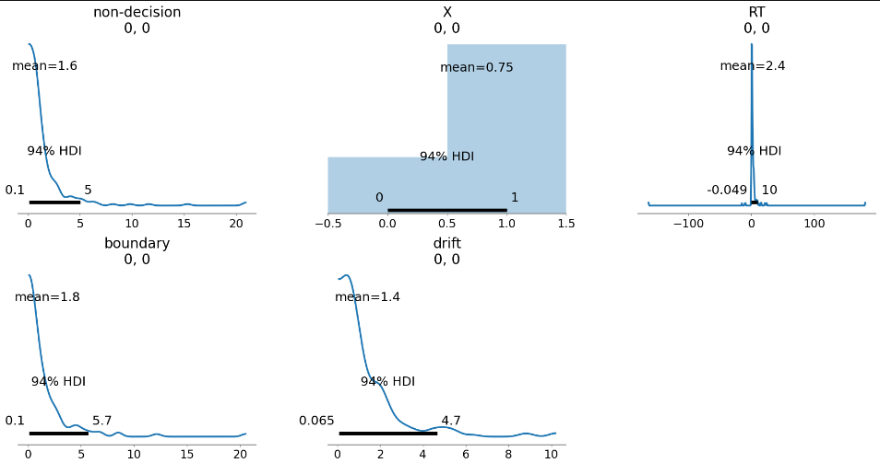
Evaluate Distributions of the Model

Slide 19
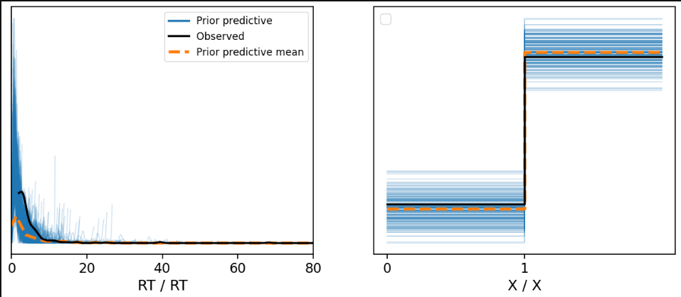
Prior Predictive Check – Dataset (Easy)

Slide 20
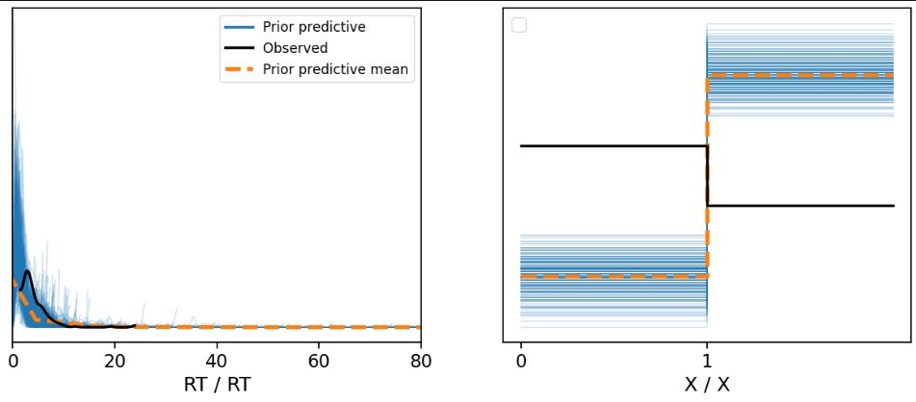
Prior Predictive Check – Dataset (Hard)

Slide 21
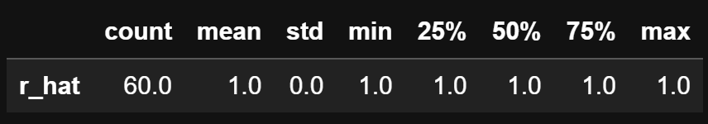
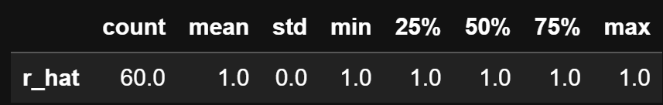
Model Fit - 𝑅 (hat)
Easy
Hard

Slide 22
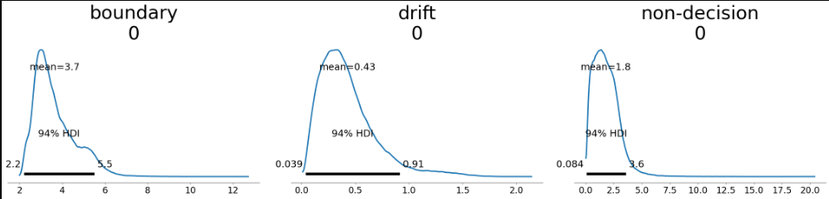
Posterior Distribution – Easy Dataset

Slide 23
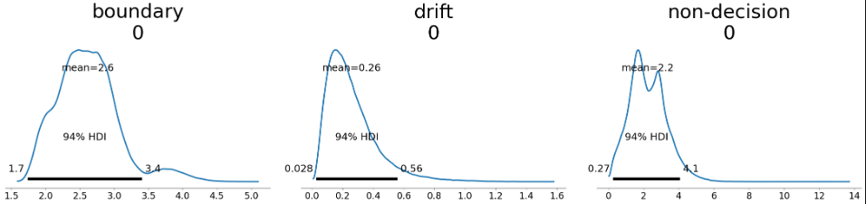
Posterior Distribution – Hard Dataset

Slide 24
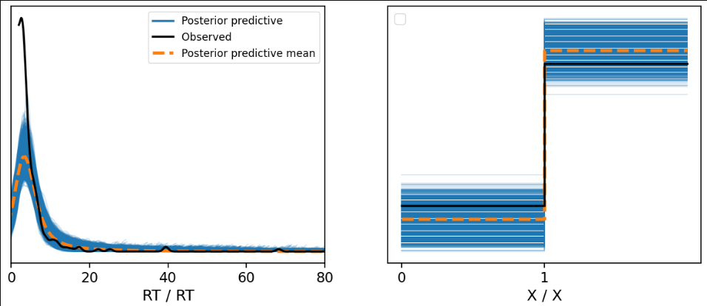
Posterior Predictive Distribution – Easy Dataset

Slide 25
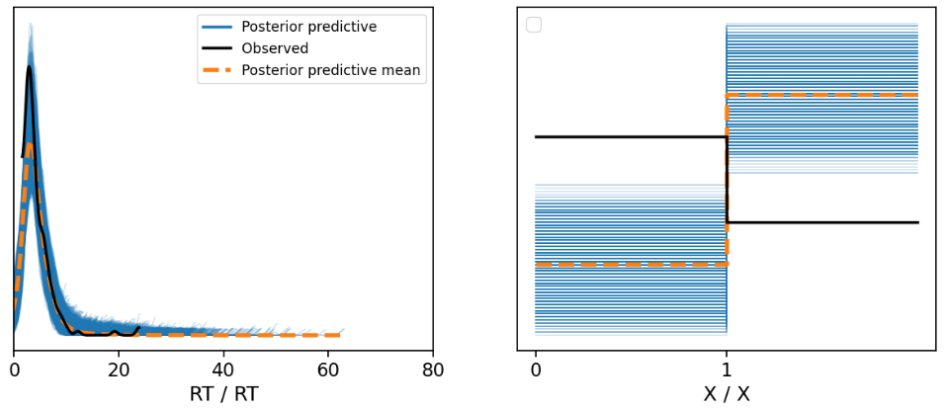
Posterior Predictive Distribution – Hard Dataset

Slide 26
Examine EZ-Diffusion model parameters
Comparing Easy & Hard Datasets

Slide 27
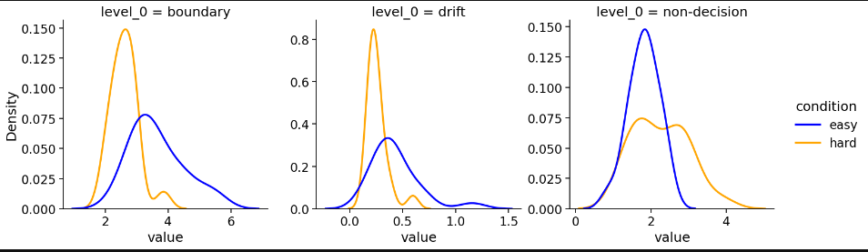
EZ-Diffusion Parameter Estimates

Slide 28
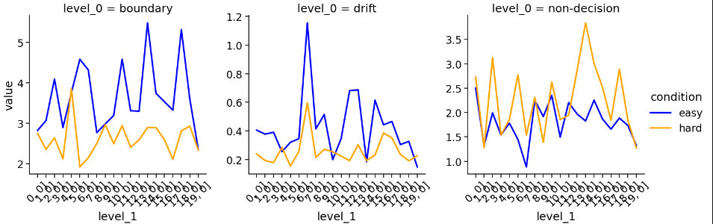
EZ-Diffusion Parameter Estimates

